Slide 1
Bayesian inference of conformational ensembles from small-angle scattering data
Wojtek Potrzebowski
Data Management and Software Centre, ESS
Biochemistry and Structural Biology, LU
www.europeanspallationsource.se
4 May 2019

Slide 2

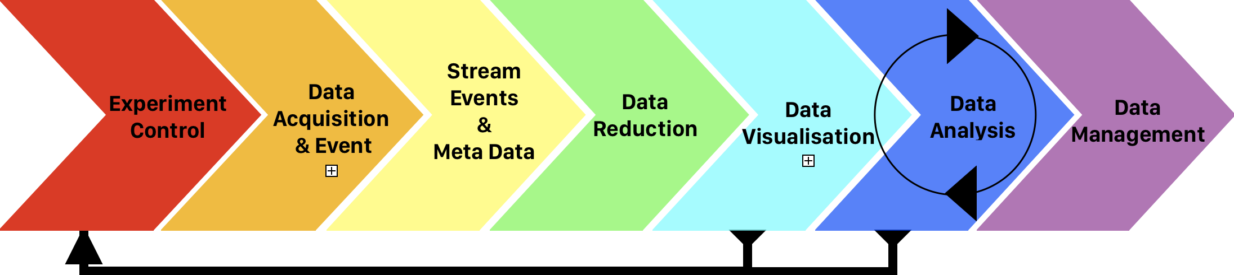
Data Management and Software Centre provides scientific computing for ESS
To Do:
Scientific computing
for all instruments
Notes:
European spallations source is a pulsed source curently under construction, which will produce 100x brighter neutron when it is operaring in full mode.

Slide 3

DMSC balances scientific impact with entry barrier
Minimise the time it takes to understand experimental data
Maximise the scientific impact and success of ESS
Notes:
The top-level objective of DMSC is to balance entry barrier and the time it takes to understand experimental data with maximising scientific impact of ESS>

Slide 4



But science happens also outside ESS…
Ingemar André, Lund University
Jill Trewhella, Univ. of Sydney
Notes:
Present method and how to use it and no Bayesian is required. Screen shot.

Slide 5
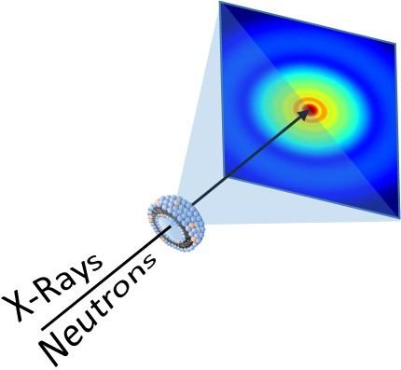
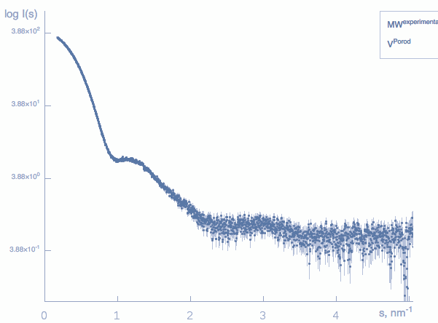
Monodispersity is desired in SAS experiment
X-rays
Neutrons
Monodisperse sample
Adapted from Di Cola et al. Pharmaceutics, 2017
Notes:
Small angle scattering experiemnt is greatly facilitated when it is perfomed on monodisperse molecules. From such data set one can readily extract structural paremeters such as the Rg or molecular mass.

Slide 6
Polydispersity complicates structural determination
X-rays
Neutrons
Size polydispersity
Shape polydispersity
Conformational polydispersity
Notes:
However, very often structure determination is comlicated by the presence of sample polydispersity. Which may involbe shape polydispersity where we have same type of molecule which differs in the overal shape. Size polydispersity wgere we have a mixture of components arrising drom the same builiding blocks and then adopting different oligomeric states. And eventually we can osberve conformational polydispersity where moleciules have same MM but distinctively different conformations. The method I will present in the rest of this presentations can in principle handle of these types of polydispersity. However it will be demonstrated on the case from the last group.

Slide 7
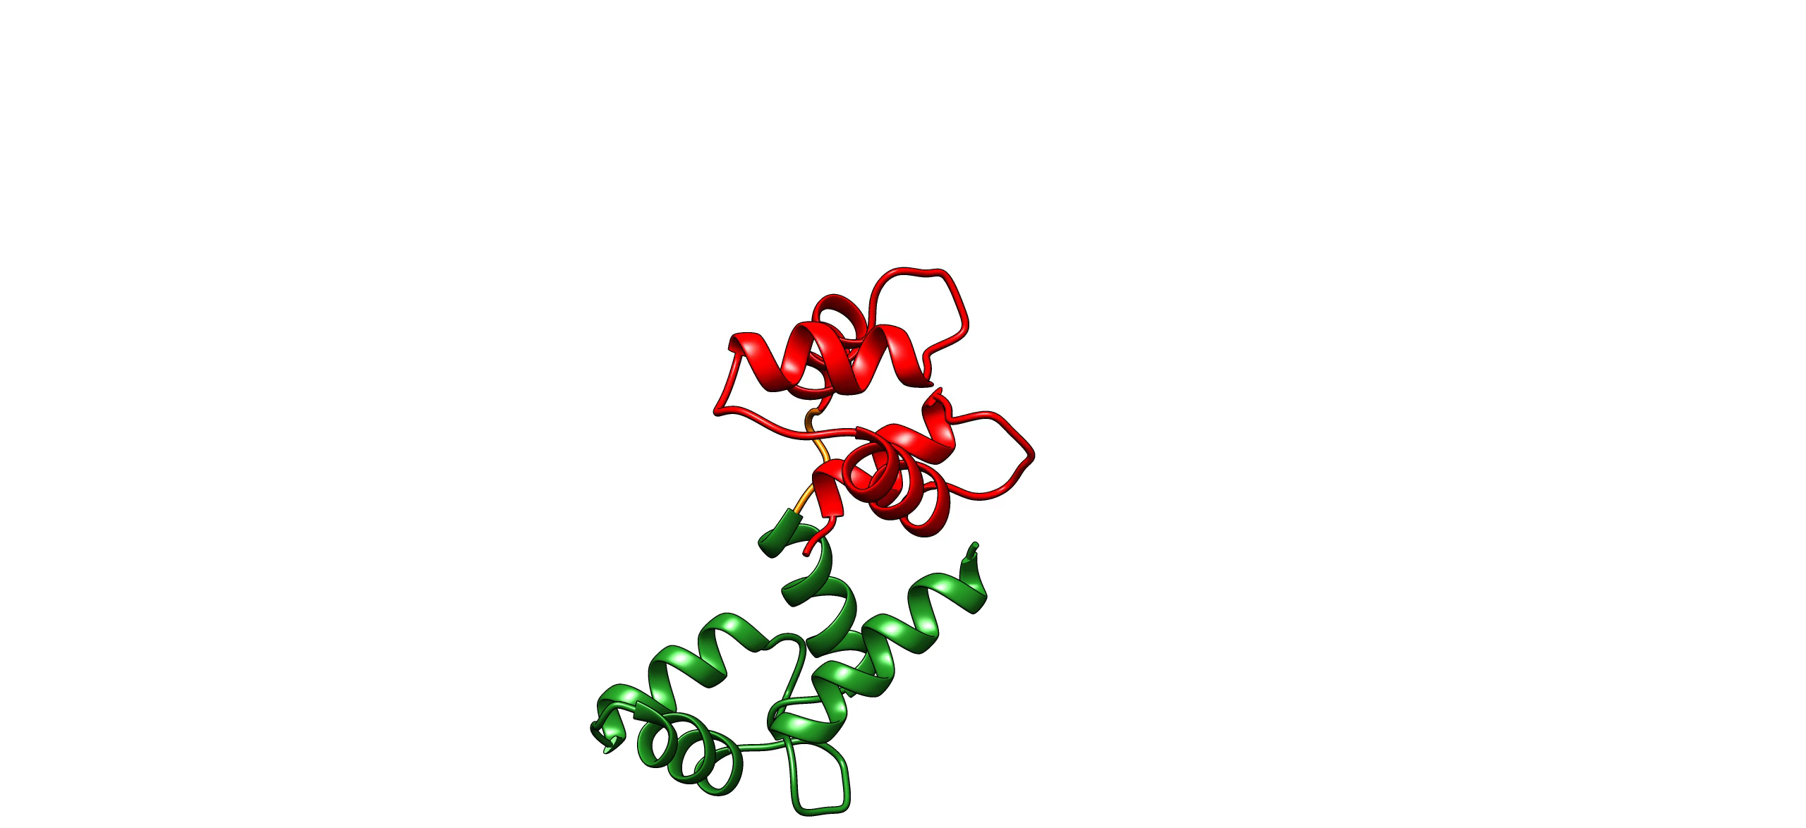

Proteins with flexible linkers are attractive targets for SAS experiments
Calmodulin (CaM)
Cardiac myosin binding protein C (𝛥mC2 )
Notes:
As we’ve been particularly interested in studying two protein systems, which contains two folded comains connected by flexible linker.

Slide 8
Challenges for analyzing poldydisperse data
Scattering from the mixture of components
Low information content
Overfitting to experimental noise
Optimization problem – thousands of parameters
Notes:
However analyzing SAS data obtained for such ensembles is not trivial and there are a few major challanges to be faced.
I will go briefly through them as well as will try to explain how we addressed them in the developed method.

Slide 9
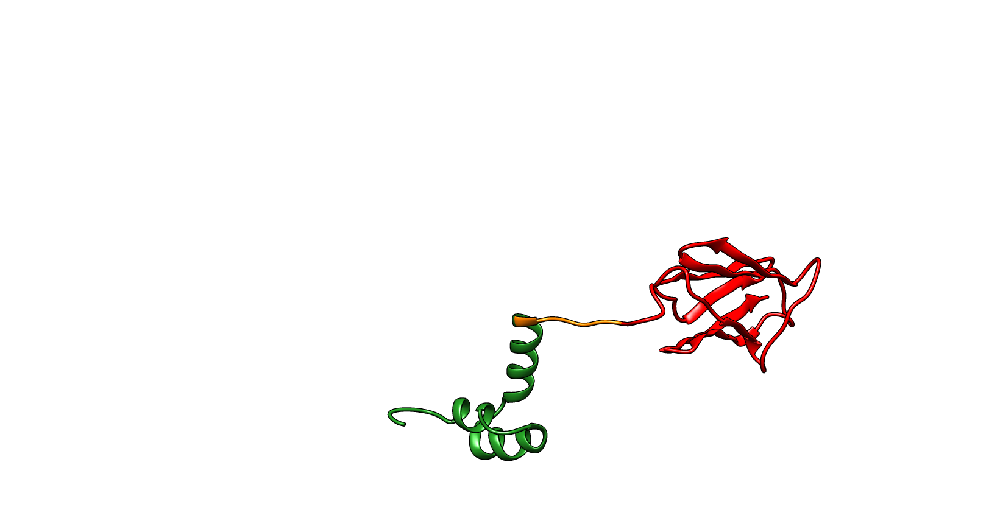
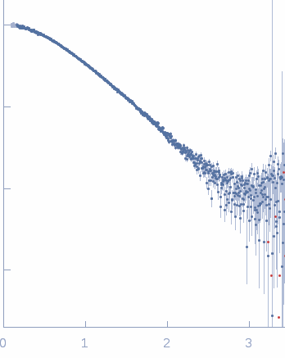
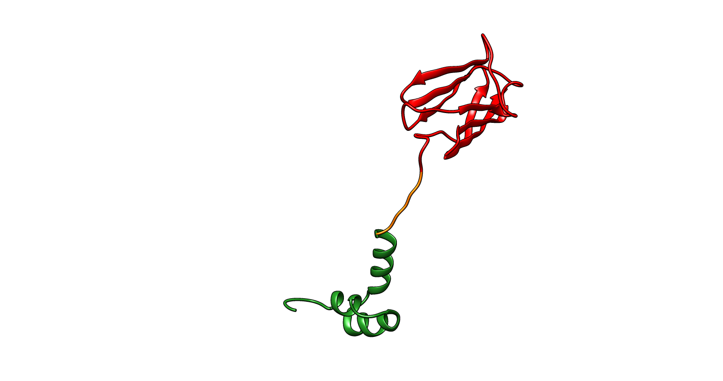
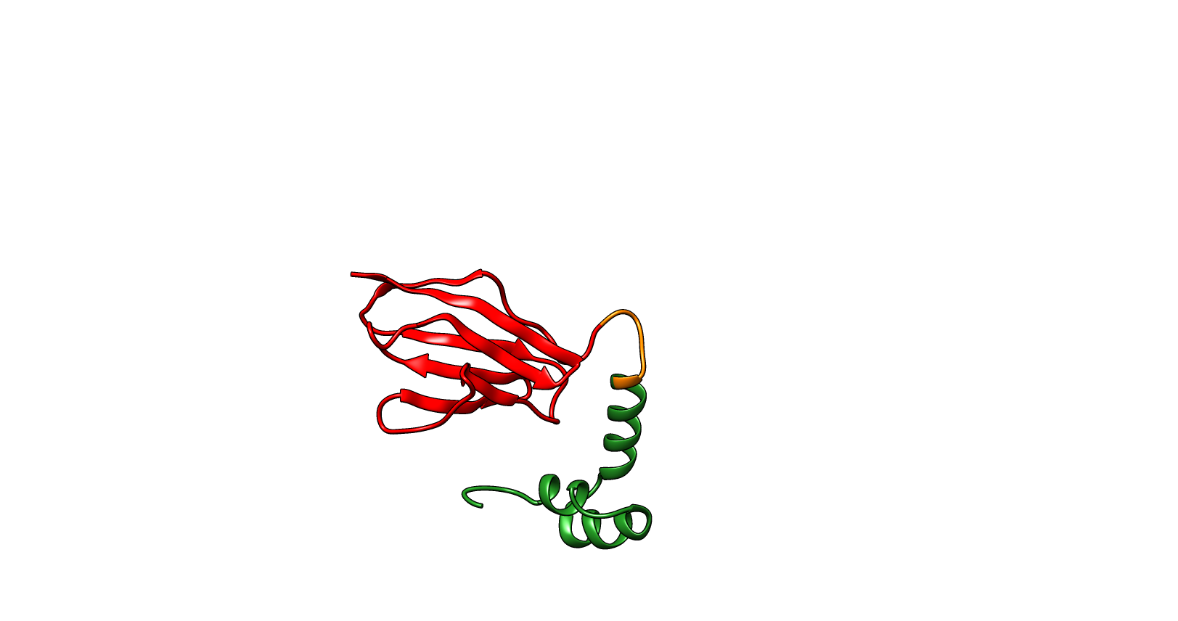
Multiple conformations contribute to scattering curve
w₁
log(I)
w₂
w₃
Q[1/Å]
w₁ +w₂ +w₃ =1
Notes:
As I already mentioned at the begining we consider a polydisperse sample where SAXS data is averaged over different conformations that give rise to the one scattering pattern. In order to define an ensemble we need to define conformation and corresponding population weights,

Slide 10
SAS data contains limited structural information
The number of independent data points estimated from Nyquist-Shannon sampling theorem or maximum entropy regularization (Vestergaard and Hansen (2006))
Shannon points
Number of points
Good points
Increasing noise
The number of independent measurement rarely exceeds 5-15.
Notes:
The other challenge is related to fundamental loss of information in SAXS experiment. A few attempts have been made to quantify the amount of structural information. The popular method based on Nyqist-Shannon sampling theorem asses number of independent points in the data based on maximu dimension and scattering vector range. It doesn’t however account for noise in the experimental data, which is taken account by method based on the maximum entropy, resulting in the number of good points. The number of good points decreases when the noise increases. Regardless which method we use to quantifiy number of independent points in the data we typically arrive in the range between 5-15. Which limist the number of parameters in the model that can be supported by the data.

Slide 11
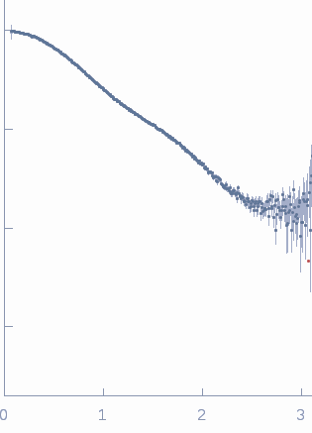
SAXS data contains limited structural information
Calmodulin (SEC-SAXS)
Cardiac myosin-binding protein C (SAXS)
log(I)
log(I)
Q[1/Å]
Q[1/Å]
N_{s} = 6.4
N_{s} = 8.7
N_{g} = 5.1
N_{g} = 6.1
Notes:
For the two systems we’ve been working on number of good and Shannon points are in the range between 5 and almost 9.

Slide 12
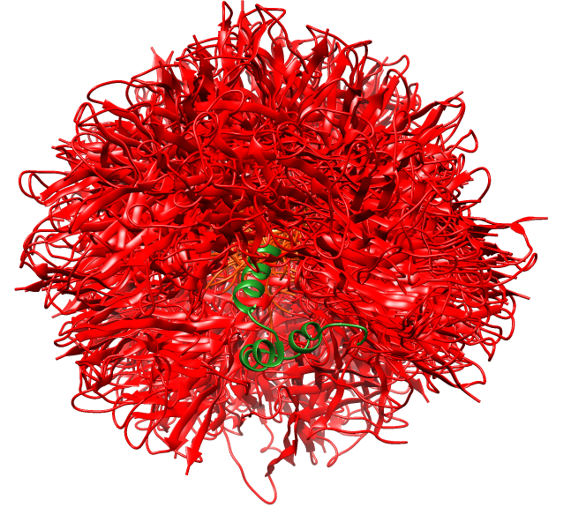
Many parameters describe conformational ensembles
Thousands of parameters may be required to define ensemble
Ensembles can be represented in discrete or continuous space
𝞆² based optimization leads to overfitting
Notes:
As we just established the number of parameters that can reliably supported by the data is in the order of 10. which is typically at least one order of magnitude lower than what is required to represent conformational ensemble. These ensembled can be represented as a continous set of parameters or a discrite set of conformers. In any

Slide 13
What do we want from our inference method?
We want to extract as much information from the experimental data – but not more than that
Avoid overfitting to experimental noise
Quantify the uncertainty in the inference
Combine multiple sources of data: simulation and experimental data sources
-> Bayesian Inference to the rescue!
Notes:
These above mentioned challanges define necessary features that inference method should contain. These can be summarized by.

Slide 14
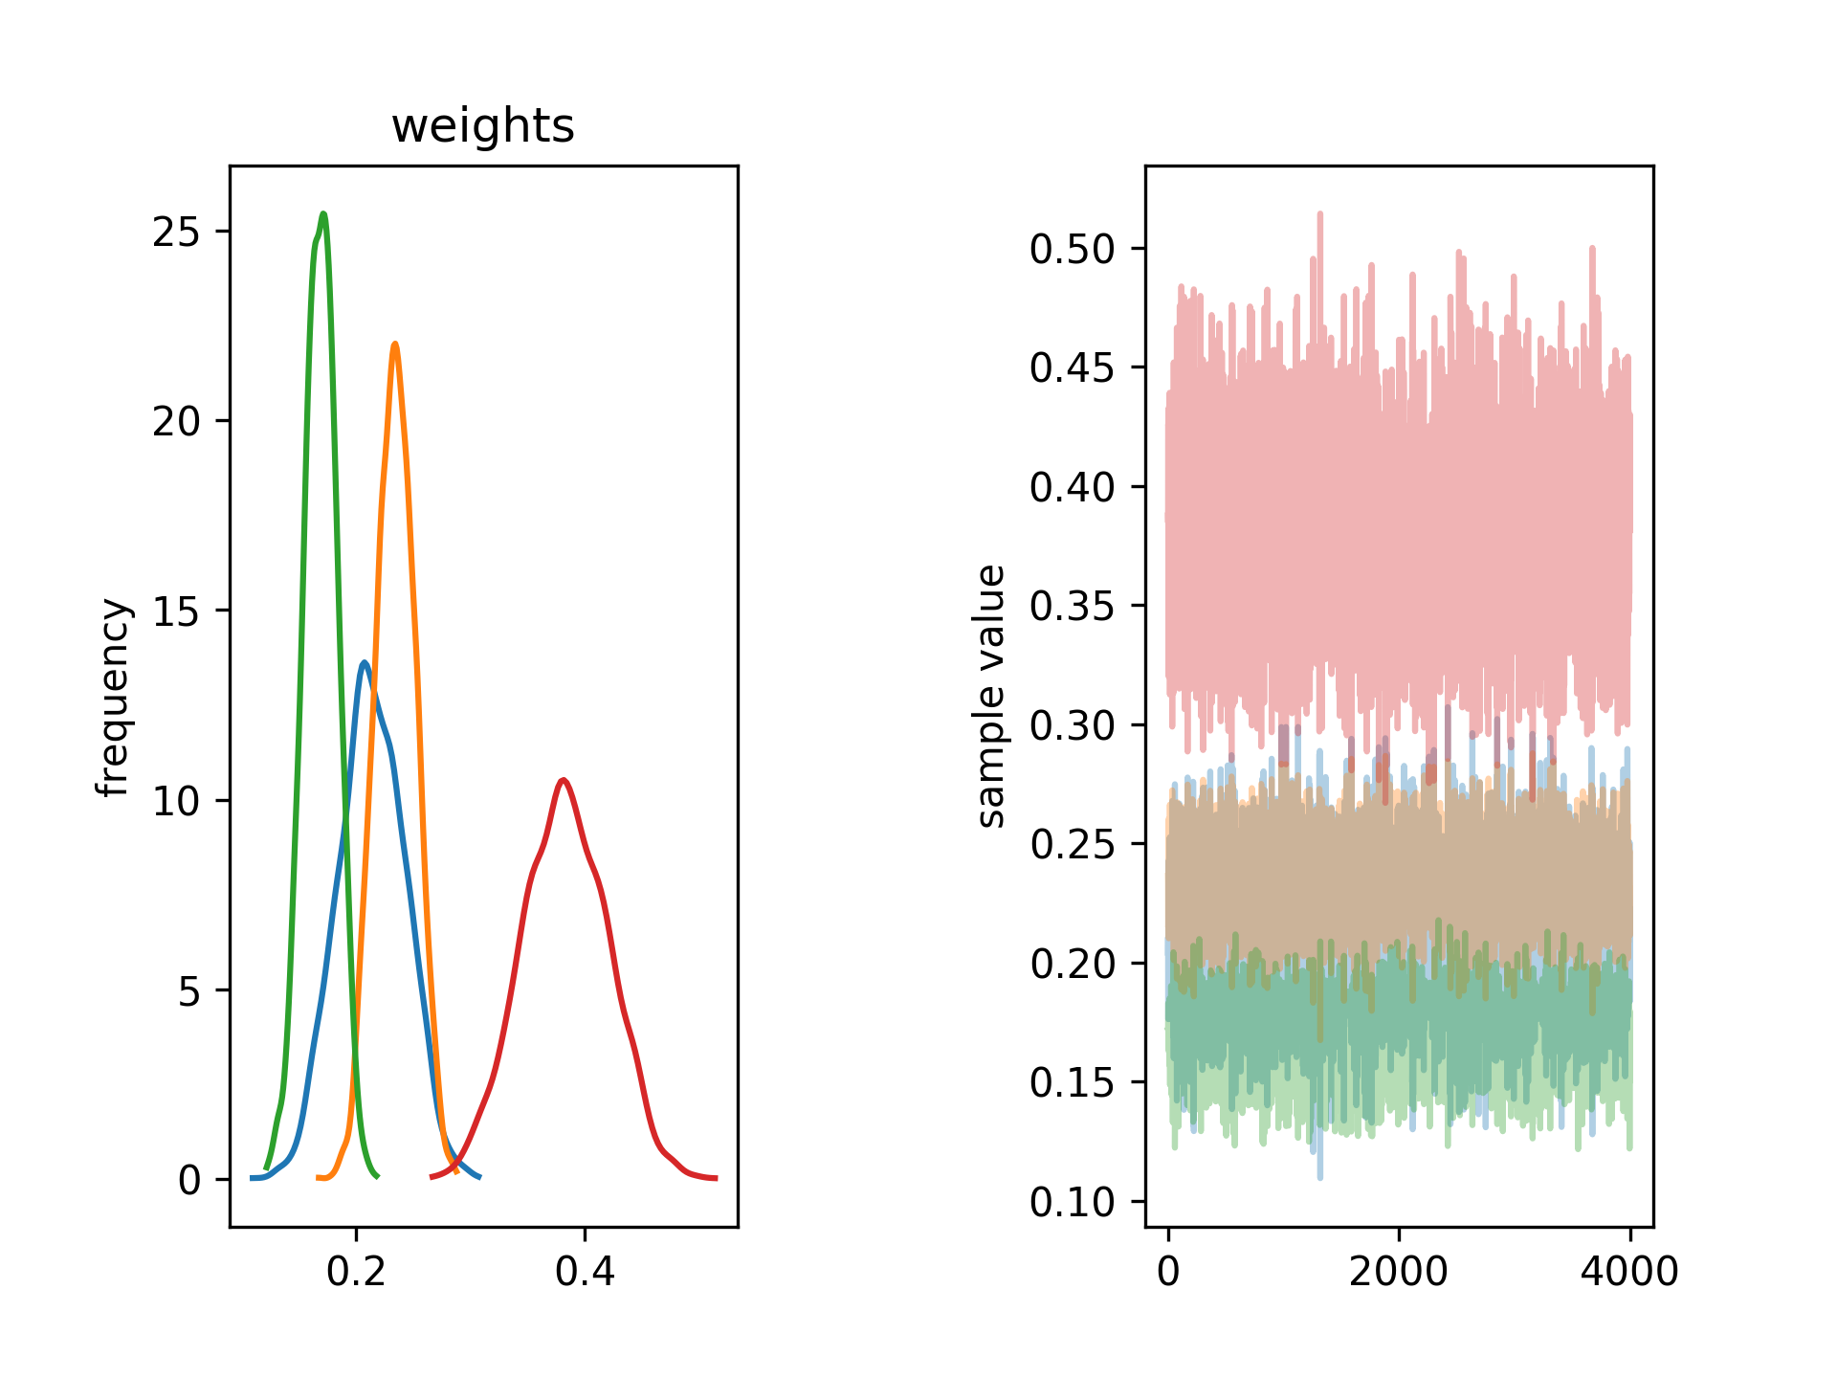
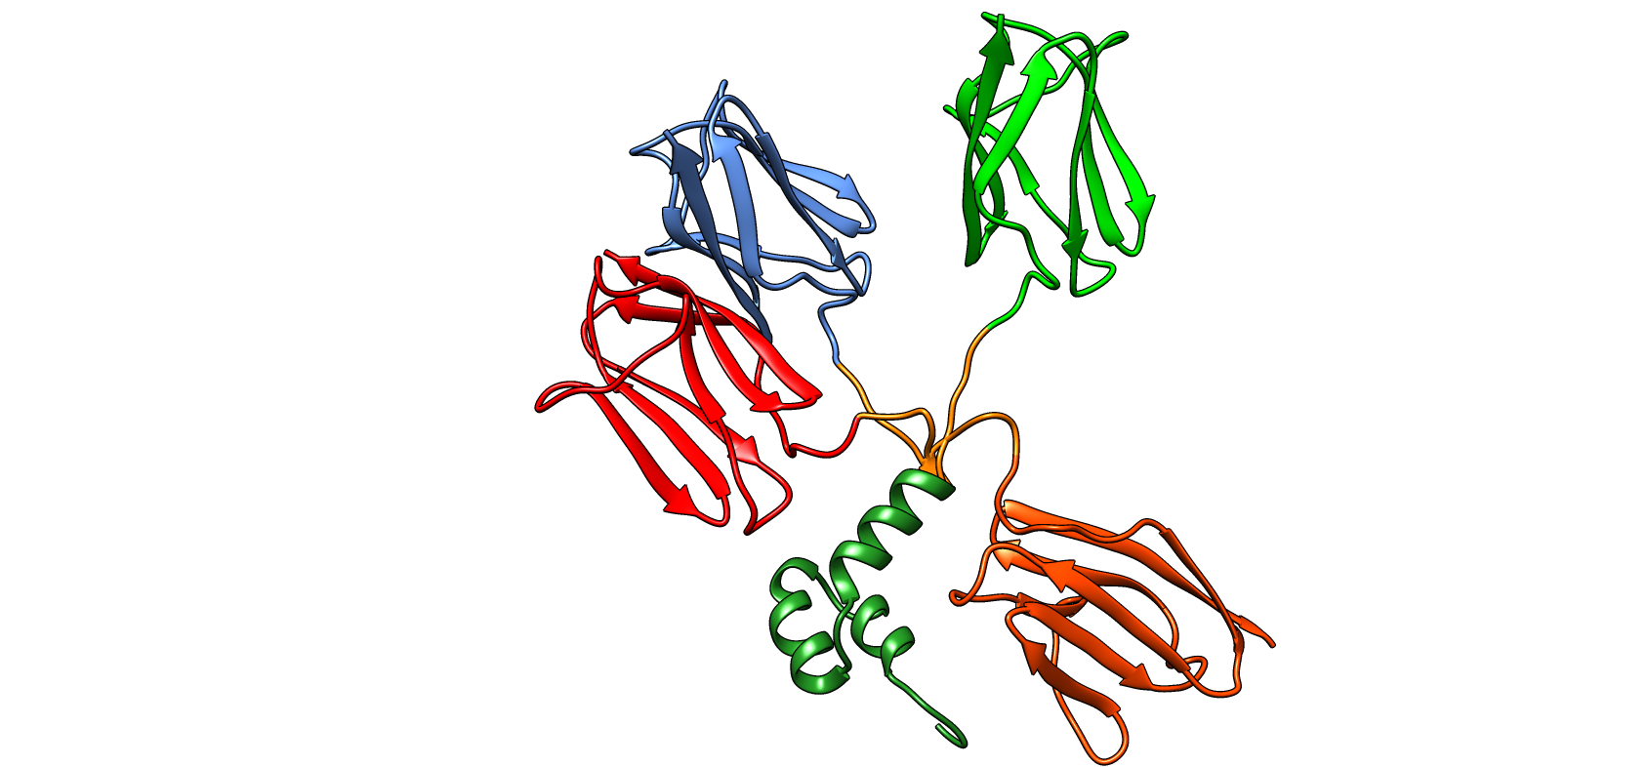
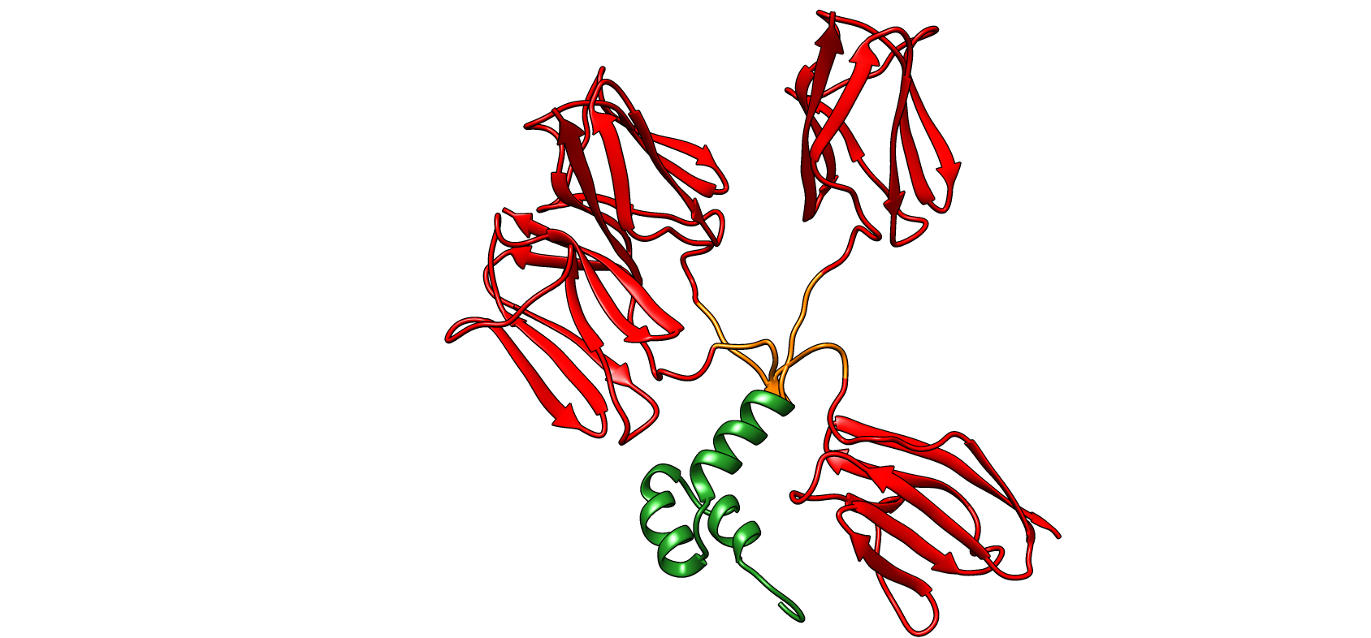
Method to infer conformational ensembles
W₁ = 0.2 W₂ = 0.3 W₃ = 0.5
Monte Carlo simulations
Model selection
Weights inference
SAXS
NMR
Rosetta structure prediction
Approximate Bayesian
Complete Bayesian
Notes:
We developed method that uses Bayesian statistics to determin conformational ensembles from a set of structural discrete models generated Rosetta structure prediction program. Our method primarily works with SAXS data but can also be complemented by NMR chemical shift data. In order to use a full benefit of Bayesian inefernce as well as otimize for speed we are using approximate variational inference to select models an complete Bayesian inference to infer final weights and their distributions.

Slide 15
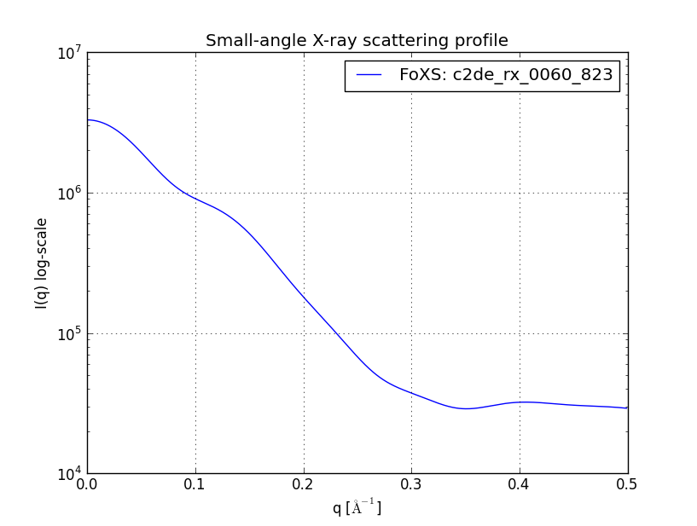
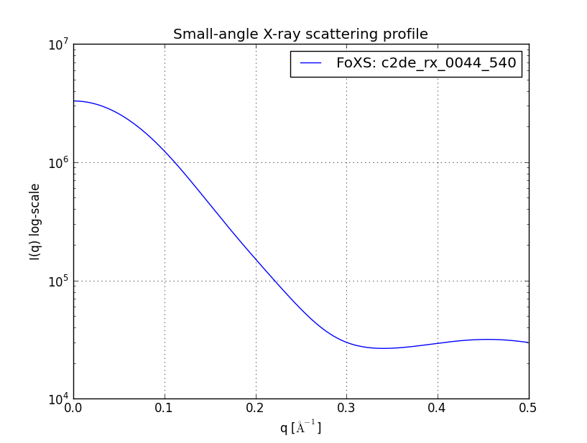
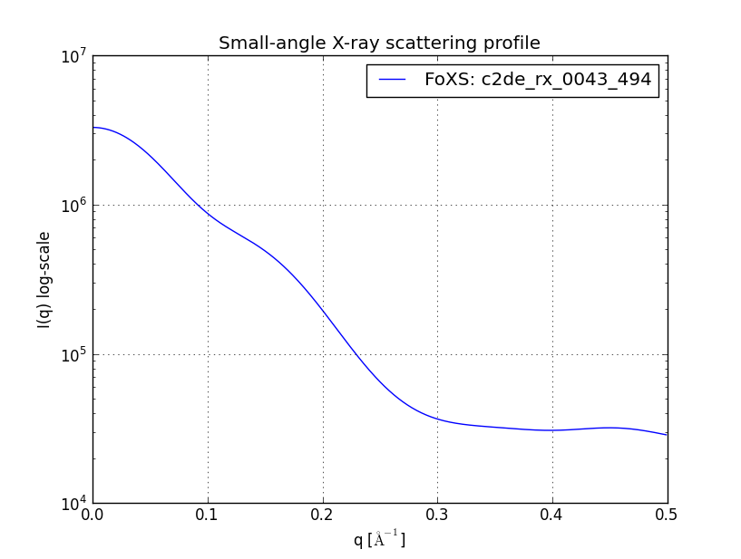
Scattering patterns are generated after Rosetta modeling (once)
w_{n}
Experimental
w₃
w₂
w₁
Crysol, FOXS

Slide 16
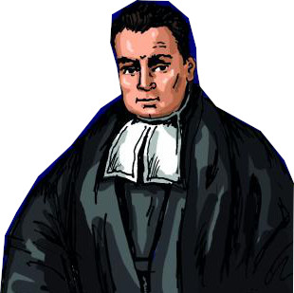
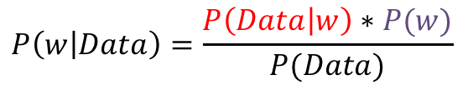
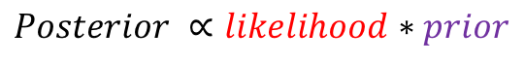
Bayesian statistics can be applied to infer weights
Bayes rule:
$$P\left(w | Data\right)=\frac{P\left(Data | w\right)∗P(w)}{P(Data)}$$
P(weights)
$$Posterior ∝likelihood∗prior$$
Thomas Bayes
weights
Posterior $\left(P\left(w | Data\right)\right):Probability of w after observing data$
Prior ($P(w)):Information before observation of data$
Likelihood ($P\left(Data | w\right)):Probability of observing data given w$
$$P\left(Data\right):Normalization constant also refered to Model evidence$$
Notes:
Just a quick reminder about Bayesian statistics as we already heard a bit about them. Bayeisna inference is governed by a simple Bayes rule which couples priror distribution with likelihood functions in order to obtain posterior probability distribution over the parameters of intrest, which is normalized by the constant also refered as model evidence. Visulay illustrated at this small graph.

Slide 17
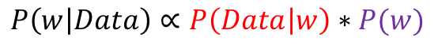
Approximate and complete inference complements each other
Approximate Bayesian inference – fast, less accurate:
Dirichlet distribution
Normal distribution
Simulated annealing
$$P\left(w, Ensemble | Data\right)∝P\left(Data | w, Ensemble\right)∗P(w|Ensemble)$$
Assume Dirichlet distribution
Complete Bayesian inference - slow:
Normal distribution
Dirichlet distribution
Hamiltonian
Monte Carlo
$$P\left(w | Data\right)∝P\left(Data | w\right)∗P(w)$$
STAN
Notes:
The variants of Bayesian inference we are using in our method are also governed by thsi rule and can be defined in simillar. The main difference arise from the fact that in the variational inferece conformations in the ensemble are optimized. This optimizatin us convinently dobe using approximate inference as we trun it into optimization problem by assiming the type of posterior distribution, which allows both for complexity quantification and speed up. Complte Bayesian inference is slow but it is perfomred on the limitted set of conformers and is perfomed using Hamiltonian Monte Carlo sampling. For the completness of definition of the terms in Baye rule I should mention that we use Dirichlet distribution to define priors, which is due to the fact that parameters in this distribution sum up to one, which is convinet way to constrai population weights. And that we apply Normal distribution to define likelihood functions.

Slide 18
Combining multiple data sources increases structural information
$$P\left(w | SAXS,NMR, conformer energy\right)∝P\left(SAXS | w\right)∗P\left(NMR | w\right)∗P(w\left(conformer energy\right))$$
SAXS data –
Rigid body orientation of domains
NMR chemical shift data –
Local contacts
Energy of conformer from energy function –
stereochemistry and intramolecular interactions
Notes:
This is also tru for NMR data and we additionally assime that each data point is indepent, which makes the overall formulation of likelihood function mathematically tractable. And this how we describe experimental data. In contrast in order to incorporate information about energy of the conformers that we obtain from molecular simulations with Rosetta we bias the definition of prior. Alltogher we have a framweork to introduce different sources of structural data.

Slide 19
Approximate Bayesian inference balances complexity with fit to the data
Fisher CK, Ullman O, Stultz C. (2012 )
Pacific symposia on biocomputing.
For a given set of conformers
Infer weights of all members of ensemble
Remove conformers with population below a threshold w_{cut}
Evaluate model evidence
$$P\left(w, Ensemble | Data\right)=\frac{P\left(Data | w,Ensemble\right)∗P(w|Ensemble)}{P(Data|Ensemble)}$$
Model evidence
$$P\left(Data | Ensemble\right)∝P\left(Ensemble | Data\right)$$
Notes:
I just also want to briefly mention some algorithimic details of approximate inference. The algorithm works iteratively by infering weights for a given set of conformers and then removing this which are below preset threshold wcut. Once this is done the model evidence is caluclted for selected ensemble and it is further compared with ME from previous run. If it imporves algorithm continues if not final ensemble is returned. It can be demonstrated that by optimizing model evidence, which is this denominator in the Bayes rule, we also optimize the ensmeble model given the data, which really neat approach to balance complexity to the fit to the data.

Slide 20
Method to infer conformational ensembles
W₁ = 0.2 W₂ = 0.3 W₃ = 0.5
Monte Carlo simulations
Model selection
Weights inference
SAXS
NMR
Rosetta structure prediction
Approximate Bayesian
Complete Bayesian
10 000 decoys
(1000 low energy)
3-5 conformers
3-5 conformers
Notes:
Just to remind the workflow our method before I will move on to discrbing results. We genarate about models using Rosetta structure prediction software and then we take 1000 of lowest energy. This 1000 models are subject of variational inference, which in two sytesm we explored arrived at ensembles consisting of 3-5 members and these ensemble were subsequently subject of complete Bayesian inference of weights.

Slide 21
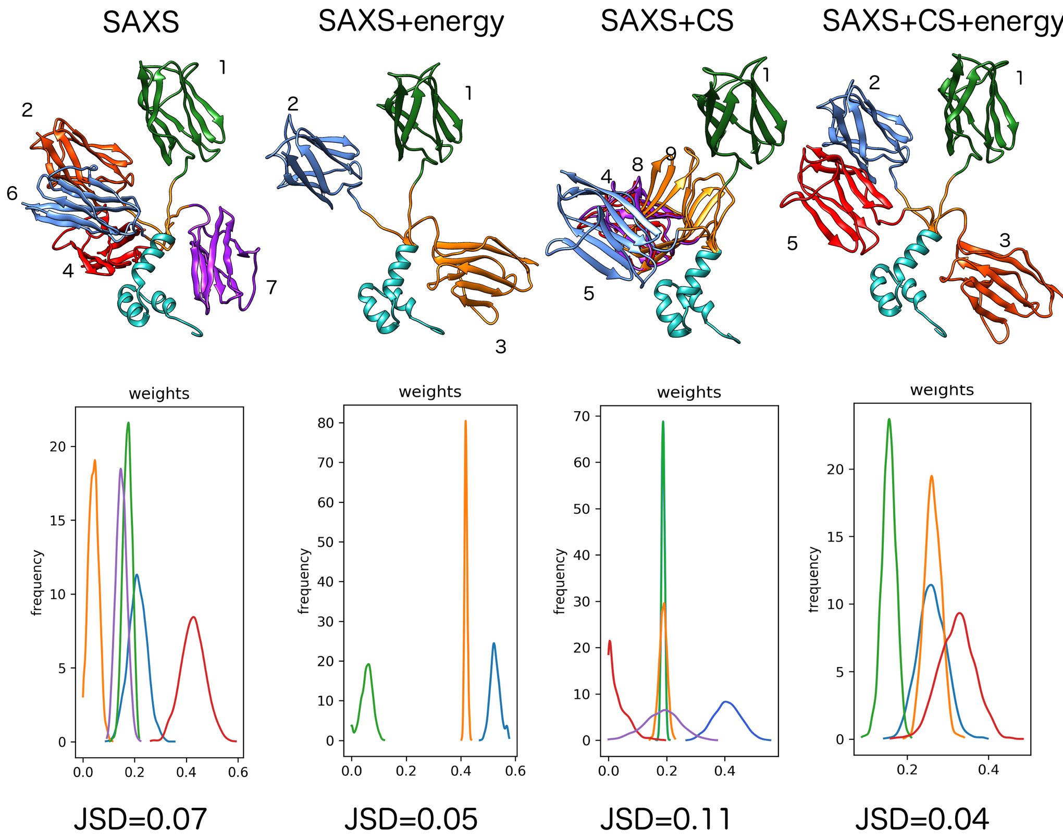
Combination of different data sources improves definition of 𝛥mC2 ensemble
energy = energy from molecular simulations
CS = NMR chemical shifts
JSD = Jensen-Shannon weights divergence
𝞆²=3.77
𝞆²=3.55
𝞆²=3.81
𝞆²=3.56
The drop in 𝞆² is the result in the improved quality of ensemble
Notes:
This is however is not always the case and in our second case study, which was based on the lower quality data, we can observe more drastic improvement of the fit to saxs data when additionat structural information is incorporated. It should be noted here that we are not optimizing chi2 to saxs data, so the fact that it decrease is improvement of the overall definition of the ensemble.

Slide 22
Conclusions
Bayesian Inference:
can be used to optimally balance model complexity and fit to experimental data
gives information about the uncertainty of inferred ensembles and parameters
allows for combining information from different data sources in one model
Our method combines the speed of alternative methods with the benefits of Bayesian inference

Slide 23

Method is available for download
https://andre-lab.github.io/bioce/

